Slide 1
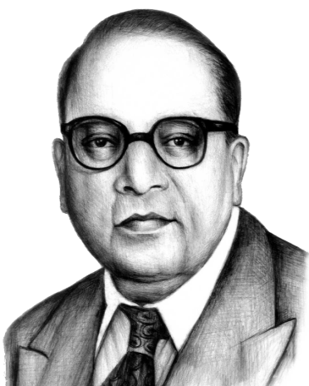

SPECKLE PATTERN
PRESENTED BY
Aditya Pratap Singh
Roll No. 237601
Enrollment no. 074/23
Under supervision of:
Dr. Devendra Singh
DEPARTMENT OF PHYSICS
School of Physical and Decision Science
Babasaheb Bhimrao Ambedkar University Lucknow

Slide 2
CONTENT
Introduction
Literature Review
Objective
Methodology GUI Layout and Controls
Speckle Simulation & Filtering – Code Logic
Expected Outcome
Results
Future Scope
Conclusion
References

Slide 3
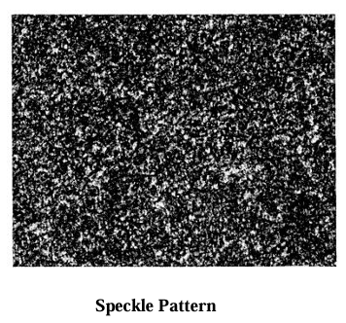
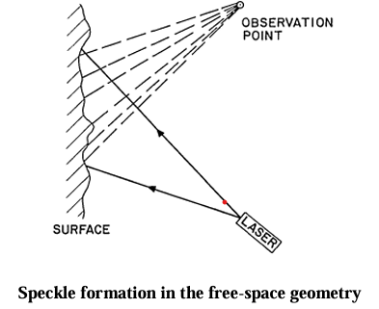
Introduction
Speckle patterns are a type of random light pattern that forms when coherent light, like laser light, hits a rough surface, the light gets scattered in different directions, creating tiny bright and dark spots. These spots, which can look like a grainy pattern, are called speckles.
Speckle patterns are caused by interference – when light waves meet, they can either combine (constructive interference) to make the light brighter, or cancel each other out (destructive interference), making the light dimmer. This process leads to the appearance of speckles.
There is mainly two types of speckle patterns Static and Dynamic speckle patterns , they have been found to be useful in many applications. For example, speckle patterns can help measure surface roughness

Slide 4
Literature REVIEW
Author (Year) | Contribution | Applications
Goodman (1975) | Explained how speckle patterns form when laser light scatters and creates interference. | Gave the basic theory behind speckle. It's the foundation for all later research.
Dainty (1984) | Showed how speckle patterns can be used to measure tiny changes on surfaces using interferometry. | Helped use speckle in scientific tools to measure small surface changes.
Briers (1996) | Used speckle patterns to check blood flow in the human body (medical imaging). | Opened new ways to use speckle in non-invasive medical diagnosis.
Xu & Liu (2013) | Used smart/adaptive filters to reduce speckle noise in medical images like ultrasound. | Improved image quality, which made it easier for doctors to read the scans correctly.

Slide 5
Objective
The main goal of this project is to create a simple and user-friendly MATLAB-based GUI that can add speckle noise to images and help in removing it effectively. The GUI will allow users to upload any image, control the amount of speckle noise they want to apply, and use filtering methods to reduce the noise while keeping the image details clear.
Another important aim is to let users adjust settings like noise strength and filter size easily through sliders or controls. The GUI will also show the original image, the generated noise pattern, the noisy image, and the filtered image side-by-side for better understanding. Overall, the project aims to provide a practical and educational tool to learn how speckle noise affects images and how it can be reduced

Slide 6
Methodology
In this project, we developed a MATLAB-based GUI to simulate and reduce speckle noise from digital images.
Upload Image Button:- Select any .jpg/.png/.tif/.bmp image
Noise Strength Slider:- Control how much speckle to apply
Add Speckle Button:- Applies random noise using FFT method
Filter Size Slider:- Choose median filter size
Remove Noise Button:- Denoise the image using simple division + filtering
Save Image Button:- Save final result to your computer
Four Image Panels:-
Original image
Speckle pattern
Noisy image
Filtered image

Slide 7
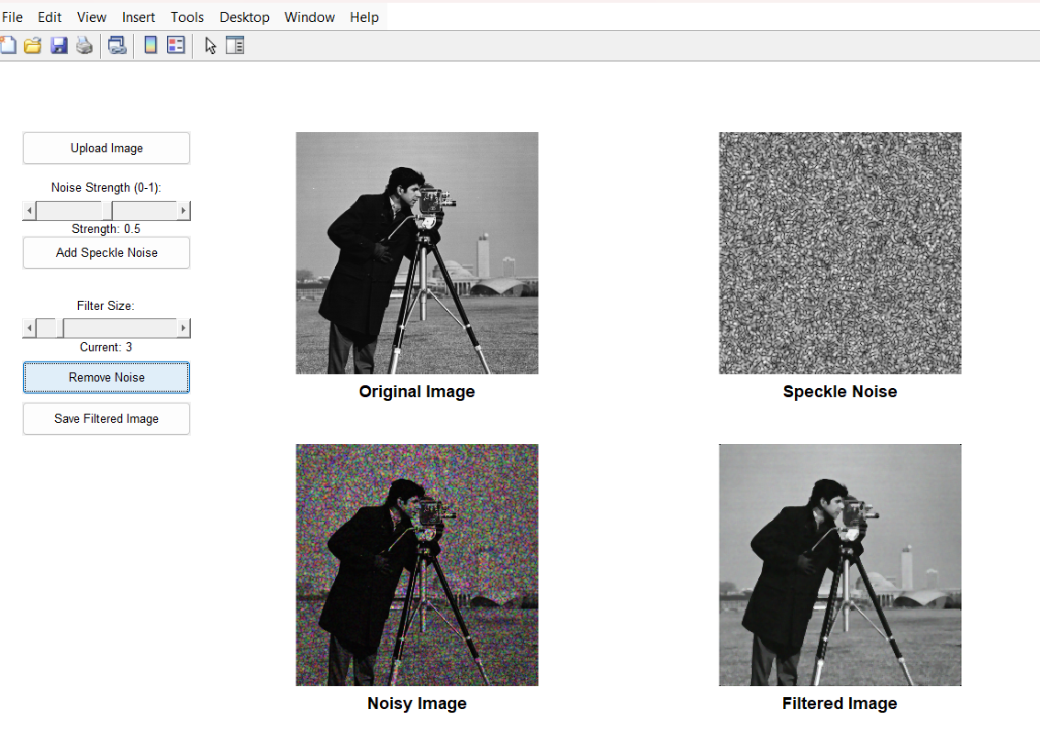
GUI Layout and Controls
Upload Image button
Noise Strength Slider (0 to 1)
Add Speckle Noise button
Filter Size Slider
Remove Noise button
Save Filtered Image button
4 Display Panels:
Original Image
Speckle Pattern
Noisy Image
Filtered Image

Slide 8
Speckle Simulation & Filtering – Code Logic
Image Upload: Grayscale to RGB, converted to double using im2double.
img = im2double(img);
Speckle Simulation Logic: Generates the speckle pattern by applying inverse FFT to a random complex field: speckle = abs(ifft2(complex_field)).^1;
Then adds speckle noise by multiplying the original image with the speckle pattern: noisy_img(:,:,c) = img(:,:,c) .* speckle;
Noise Removal: Removes speckle noise by dividing the noisy image by the speckle pattern: filtered_img = noisy_img ./ (speckle + 1e-6);
Display & Save: Normalized using imshow, saved via uiputfile and imwrite.

Slide 9
Expected Outcome
By the end of the project, a fully working and easy-to-use MATLAB GUI will be developed, which will:
Let users upload and view any image.
Generate speckle noise with adjustable strength.
Add speckle noise to the image and show the result.
Apply filtering methods to reduce the noise with adjustable filter size.
Display all stages clearly: original, noise pattern, noisy, and filtered images.
Allow users to save the final noise-reduced image easily.
Provide real-time updates when changing noise or filter settings.

Slide 10
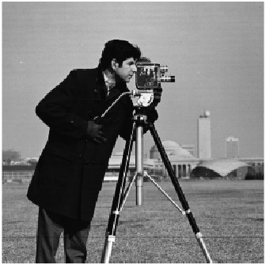
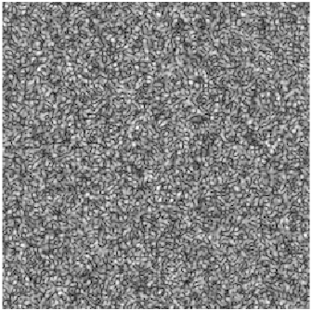
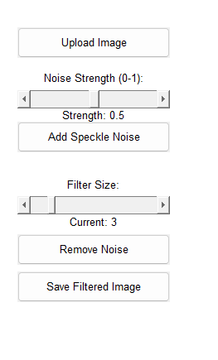
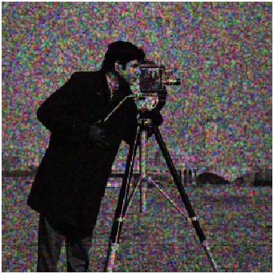
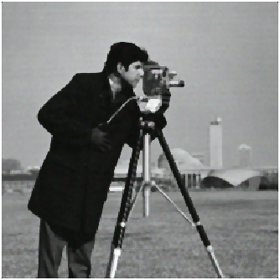
results
GUI Controls
1. Original Image
2. Speckle Pattern
3. Noisy Image
4. Filtered Image

Slide 11
Future Scope
Use better filters: We can try advanced filters like Wiener or wavelet filters for better results.
Real-time video support: We can improve the tool to work with videos or live camera feed.
Add machine learning: Using AI, we can train the computer to remove noise more smartly.
Improve the design: Make the user interface easier and more attractive to use.
Support more noise types: Not just speckle, but also remove other noises like Gaussian or salt-and-pepper.
Use in real-world systems: This tool can be added to medical or industrial machines to clean images automatically.

Slide 12
Conclusion
In this project, we made a simple tool using MATLAB to add and remove speckle noise from images.
The tool lets users upload any image, add noise to it, and then remove the noise using a filter.
It shows all steps clearly: original image, noisy image, and cleaned image — side by side.
This helps students and beginners understand how speckle noise affects images and how it can be reduced.
The method used is simple, but it works well in basic situations and helps us learn the basics of image processing.

Slide 13
References
Goodman, J. W. Speckle Phenomena in Optics: Theory and Applications. Roberts and Company, 1975.
Briers, J. D. "Laser speckle contrast imaging for measuring blood flow." Optics and Laser Technology, 1996.
Dainty, J. C. Laser Speckle and Related Phenomena. Springer, 1984.
Tyson, R. K. Principles of Adaptive Optics. CRC Press, 2011.
Fercher, A. F., and Briers, J. D. "Flow visualization by means of single-exposure speckle photography." Optics Communications, 1981.

Slide 14
Acknowledgement
I would like to express my sincere gratitude to Dr. Devendra Singh for his invaluable guidance, encouragement, and support throughout the course of this project on “Speckle Pattern”. His expertise and insights have been instrumental in shaping the direction of this work and enhancing my understanding of the subject.
I am thankful to other faculties Prof. B. C. Yadav, Prof. Devesh Kumar, Late Dr. Ramesh Chandra, Dr. Anil Kumar Yadav, Dr. Khem B. Thapa, Dr. Ajeet Kumar Maurya and Dr. Rajesh Kumar Singh who were always helpful and generous throughout this period.
I am also thankful to my friends for providing the necessary resources and facilities to carry out this project. The learning experience gained during this project has been both enlightening and rewarding, and I am truly appreciative of the opportunity.
Lastly, I extend my gratitude to my peers and family for their constant motivation and encouragement, which played a significant role in the successful completion of this project.
Thank you all for your contributions and support.

Slide 15
THANK YOU

